Slide 1
Stacks and Queues
CHAPTER 3

Slide 2
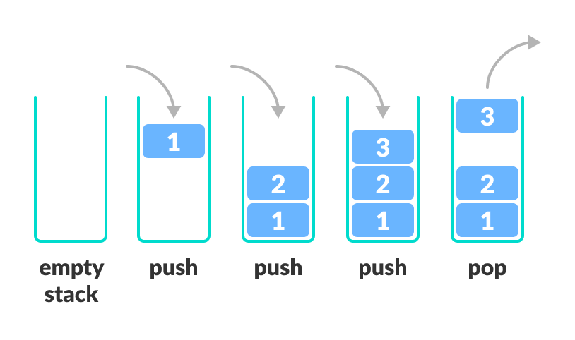
Implementing a Stack
The stack is a linear data structure that is used to store the collection of objects.
A stack uses Last In First Out (LIFO) ordering.
It uses the following operations:
pop() - removes the top item from stack
push() – adds an item to the top of the stack
peek() – returns to the top of the stack
isEmpty() – return True if stack is empty
isFull() – returns True if stack is full

Slide 3
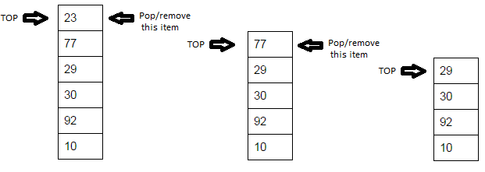
Cont…

Slide 4
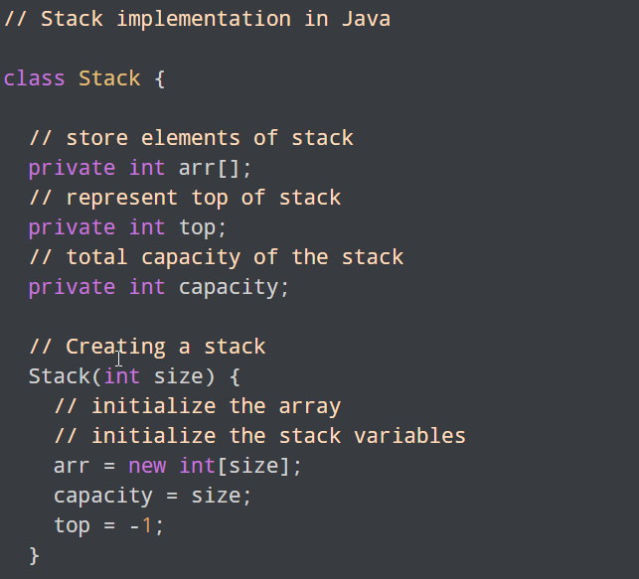
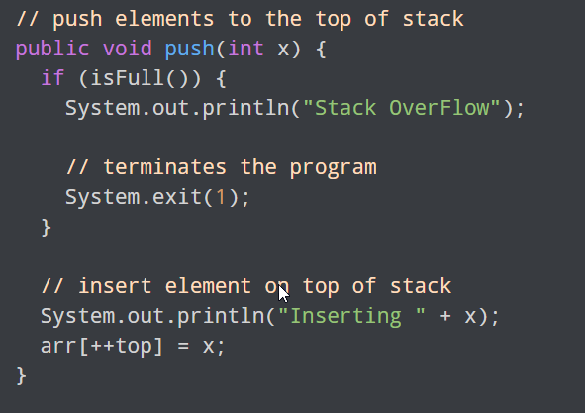
Example and Explanation

Slide 5
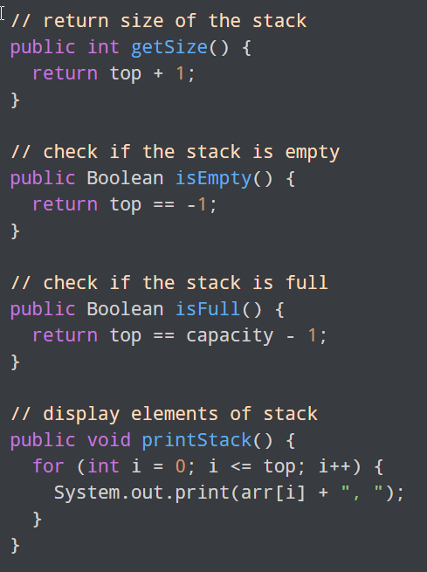
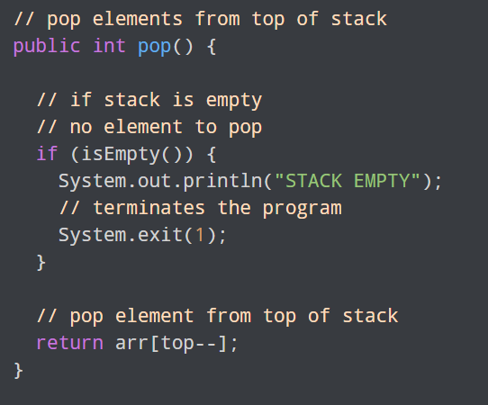
Cont…

Slide 6
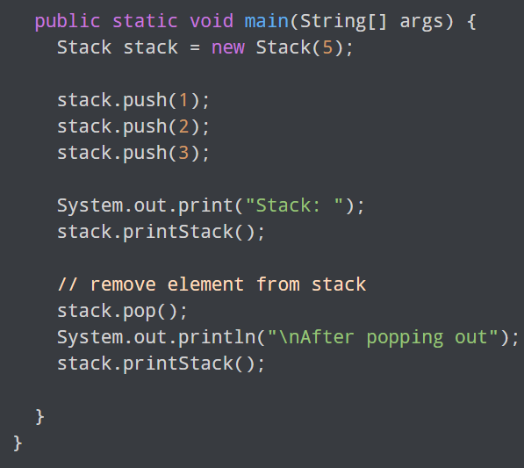
Cont…

Slide 7
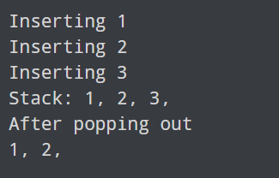
Output

Slide 8
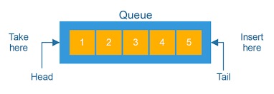
Implementing a Queue
A queue is also a linear data structure
A queue is an ordered list that uses First In First Out (FIFO) ordering.
It uses the following operations:
add() – Add an item at the end of the list
Remove() – remove the first item in the list
peek() – return to the top of the queue
IsEmpty() – return True only when the queue is empty
IsFull() – return True only when queue is full

Slide 9
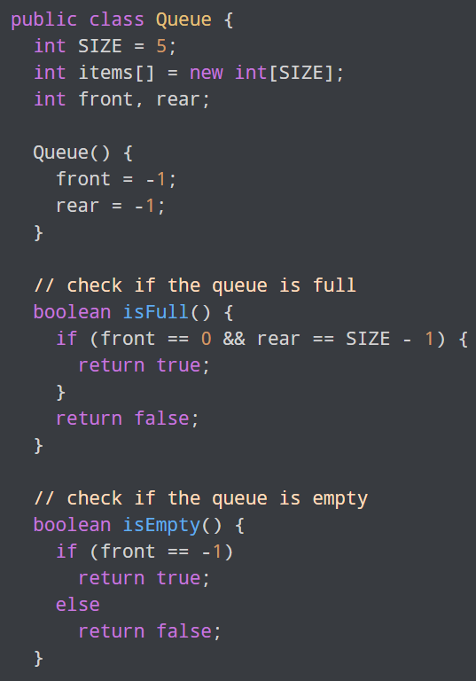
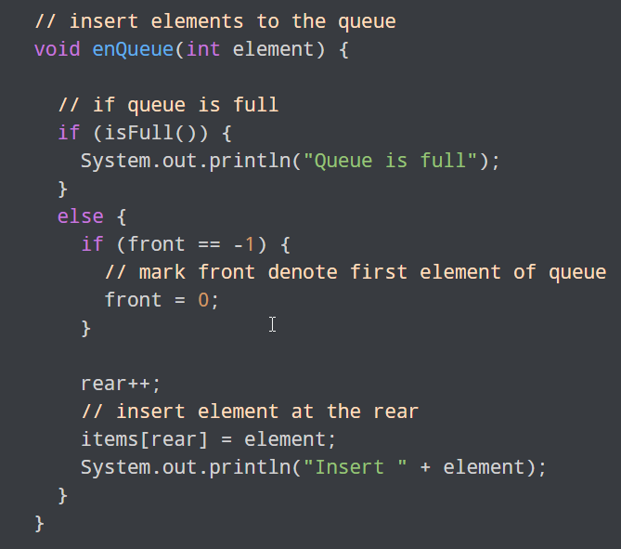
Example and Explanation

Slide 10
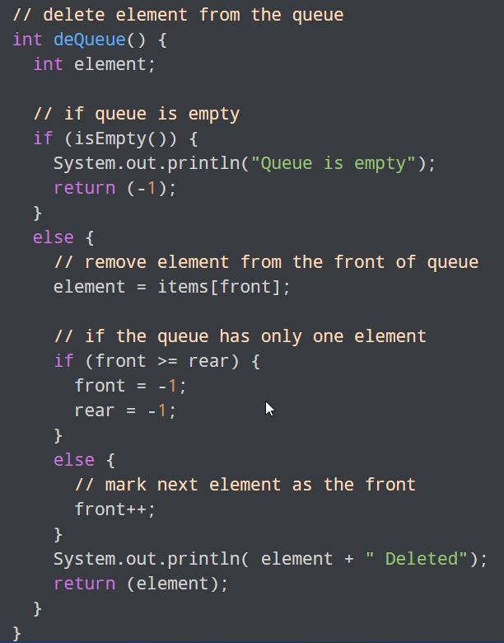
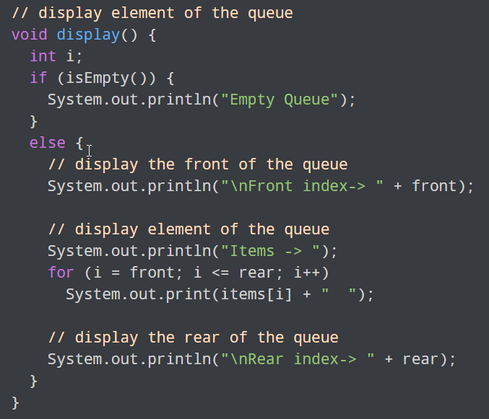
Cont…

Slide 11
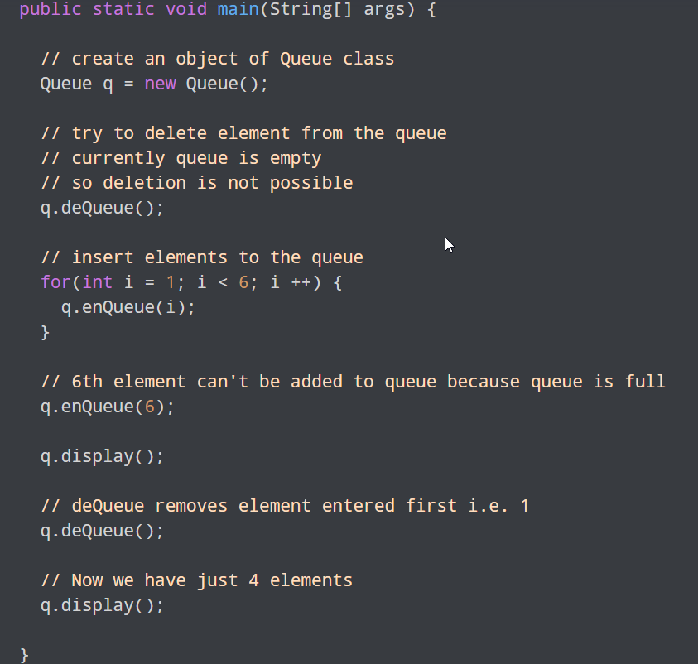
Cont…

Slide 12
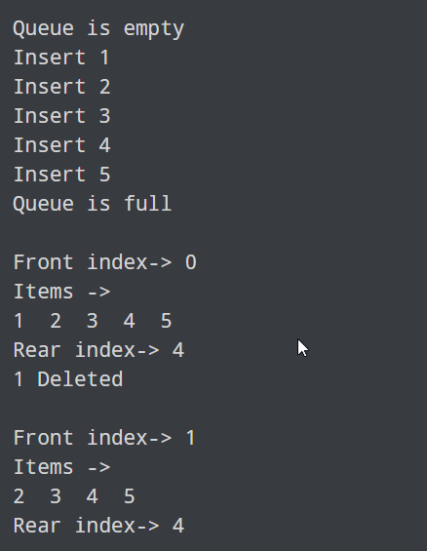
Output

Slide 13
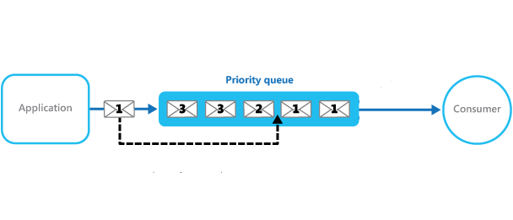
Priority Queue
A priority queue is a special type of queue in which each element is associated with a priority value whereby higher priority elements are served first.

Slide 14
END

